Slide 1

Art of Debugging
He can run but he can't hide.
By NematAllah Ahmadyan
© 2006 Sharif

Slide 2
Brothers in Arms
Assert
Trace
They are working in DEBUG Conditional, ( normal condition too )

Slide 3
Assert
Assert is a Macro, don’t mess up with function!
  Sample:
    assert( x == 10 ) ;
Defined in <cassert>
To disable #define NDEBUG
Assertion failed: x == 9, file t.cc, line 7
This application has requested the Runtime to terminate it in an unusual way.Please contact the application's support team for more information.

Slide 4
Trace
More versatile.
The debuggers have the better trace point support than just TRACE macro.

Slide 5
Visual Debugging
Can be done within IDE( or outside )
  Breakpoints
  Watch(es)
  Call_back
  Autos
  Locals
  Step /into /over /in /out & Continue
  Tracepoint
  Print Set (gdb specialist )

Slide 6
Common Debugger
gdb ( GNU Debugger )
  Comes with GCC, and every open-source IDE like Dev-Cpp and K-Develop.
  Appendix.M of D&D C++ How to Program 5th Ed.
Microsoft Visual Studio.
  Have ONE built-in debugger for ALL .net languages.
  Appendix.L of D&D C++ How to Program 5th Ed.

Slide 7
Microsoft Visual Studio Debugger
Run only under Visual Studio Environment.
Can debug native .net code.
The solution must be build under debug circumstances.
We’re going to see VS debugger in action.
The functionality of gdb is the same, yet more versatile!

Slide 8
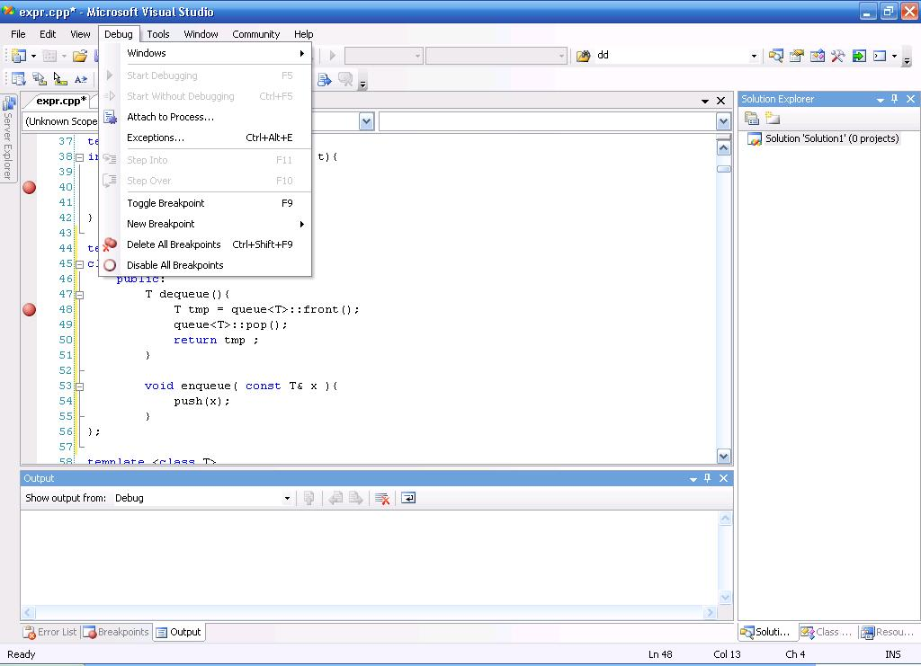
The screenshot is taken from Microsoft Visual Studio 2005 Professional Ed.

Slide 9
Sample
The following code suppose to convert string to double, it compiles but doesn’t produce the correct answer, what is the problem?
Example: -00231.123910
We’re going to use VS debugger to debug this code.

Slide 10
toDouble(String input ){
const char* digit = input.c_str();
int sign = 1 ; double result = 0 ;
if ( *digit == '-' ){ sign = -1 ; digit++; }
while (*digit >= '0' && *digit <='9') {
result = (result * 10) + *digit;
digit++;
}
if (*digit == '.') {
digit++; double scale = 0.1;
while (*digit >= '0' && *digit <='9') {
result += ( *digit ) * scale;
scale *= 0.1;
digit++;
}
}
return result ;
}

Slide 11
toDouble(String input ){
const char* digit = input.c_str();
int sign = 1 ; double result = 0 ;
if ( *digit == '-' ){ sign = -1 ; digit++; }
while (*digit >= '0' && *digit <='9') {
result = (result * 10) + *digit-'0';
digit++;
}
if (*digit == '.') {
digit++; double scale = 0.1;
while (*digit >= '0' && *digit <='9') {
result += (*digit-'0') * scale;
scale *= 0.1;
digit++;
}
}
return result ;
}

Slide 12
Boost.
Boost::static_assert
  check on compile time.
  It’s a macro, Not function!
  Sample
    #include "boost/static_assert.hpp"
    void charMustBeOne() { BOOST_STATIC_ASSERT(sizeof(char)==1);
    }
    What is the result of sizeof(‘a’) ??
    C / C++

